Slide 1


DT265A Individual Project Prescription Pain Reliever Misuse Analysis of the US 2017 National Survey on Drug Use and Health
Rosemary Keogh
Data Analytics
https://public.tableau.com/profile/rosiekeogh#!/vizhome/PainRelieverMisuse_NSDUH2017/StoryHome
https://github.com/rkok3210/DT265AProject

Slide 2
Why this project?
Interest in US Media & Politics
Aware of the Opioid Epidemic
Availability of Data
Notes:
SAMHDA Substance Abuse and Mental Health Data Archive – originally wanted geographic but since 2015 not publishhed

Slide 3
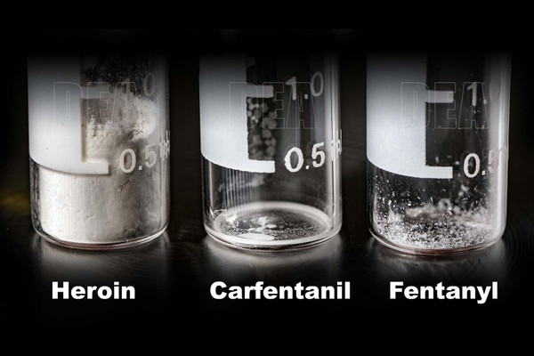
OPIOID Epidemic - INfo
Declared a Public Health Crisis in 2017
47,000 opioid overdoses
28,000 from fentanyl
17,000 from prescription opioids
Economic burden $78 billion per year
Potency of new opioids
Notes:
Fentanyl 50-100 times more potent than morphine. Cafentanil 100 times more potent than fentanyl ie 10000 times more than morphine/heroin

Slide 4


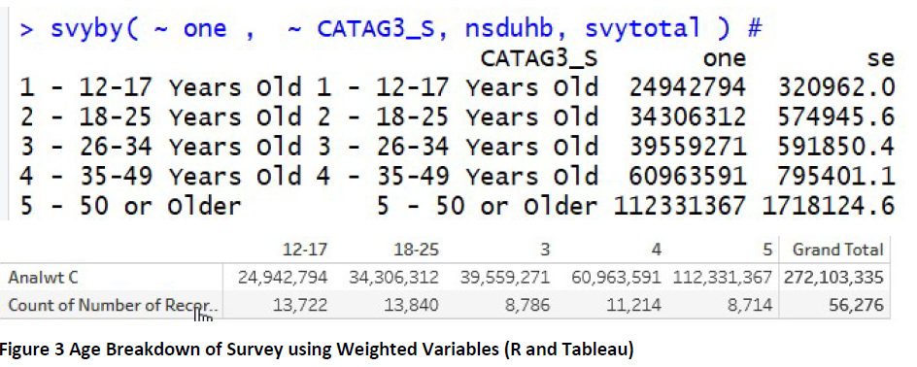
About the National Survey on Drug Use and Health
Annual survey since 1971
Approx 70,000 individuals
Weighted response rates
Represents U.S. civilian noninstitutionalized population aged 12+
Notes:
Mental health, impact on life, work, attitudes towards risk, medical cover
Step 1: Calculate the mean (Total of all samples divided by the number of samples). Step 2: Calculate each measurement's deviation from the mean (Mean minus the individual measurement). Step 3: Square each deviation from mean. Squared negatives become positive.

Slide 5
MISUSE OF Prescription pain reliever DEFINITION
Use in any way not directed by a doctor
Use without a prescription of one's own
Use in greater amounts, more often, or longer than told to take a drug
Notes:
Snorting / Injecting. Mixing with other drugs or alcohol

Slide 6
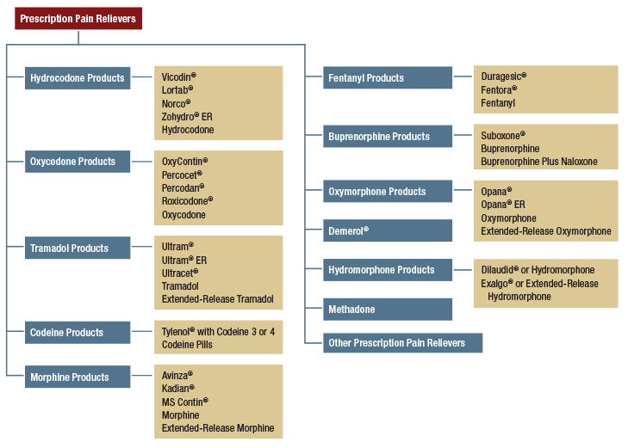
Types of Prescription pain reliever
Notes:
2013, nearly 45 million prescriptions Demerol also known as pethidine

Slide 7
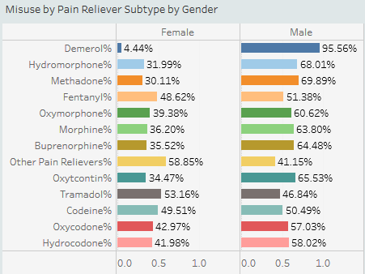
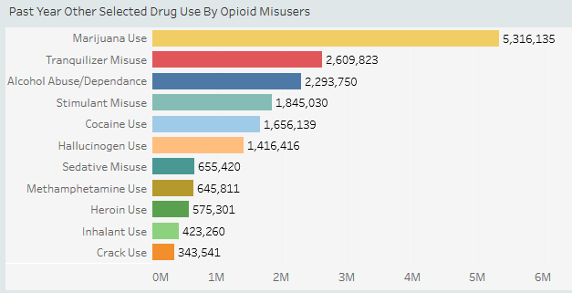
Prescription pain relievers MISUSED & Other drug use

Slide 8
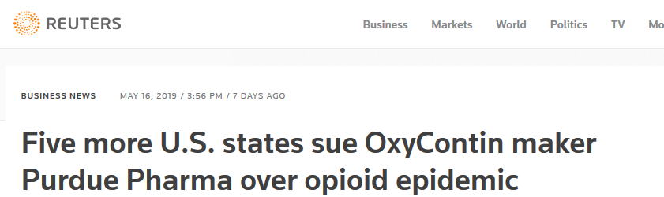
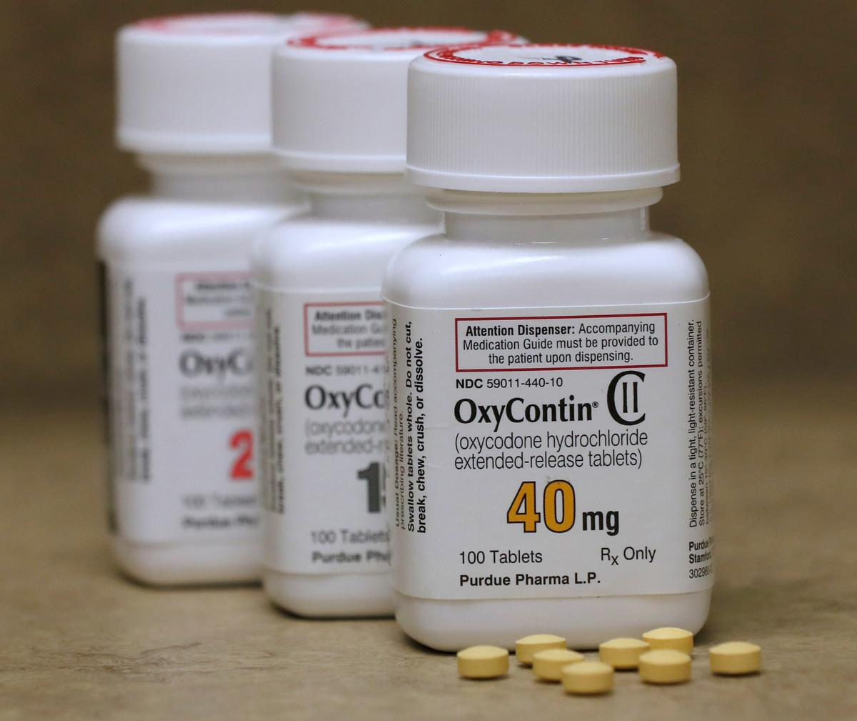
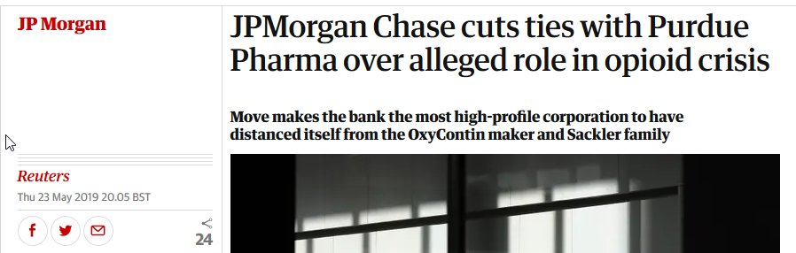
Oxycontin

Slide 9
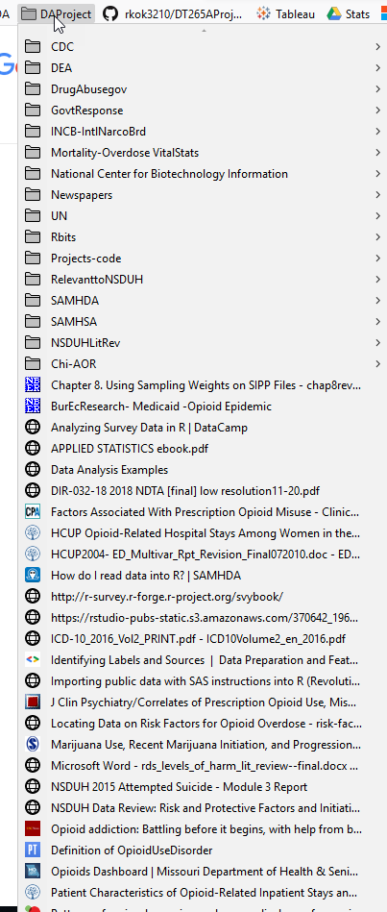
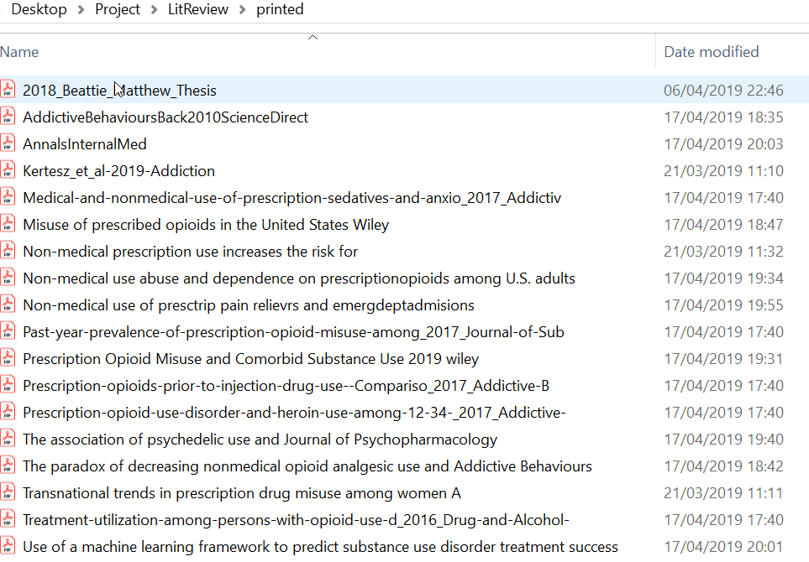
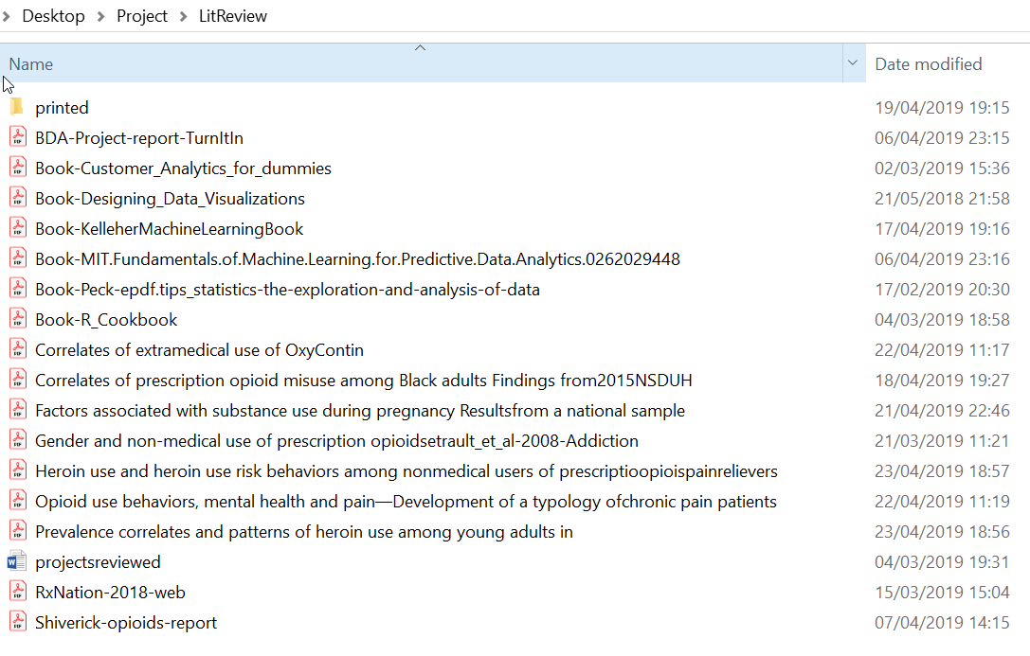
Background Research
Academic Journals
NSDUH Publications
Student Projects
Online Research

Slide 10
Background Research
Reviewed current work in the field
Ideas of variables to explore
Mainly regression, adjusted odds ratios, no visualisations
Mostly SAS & Python

Slide 11
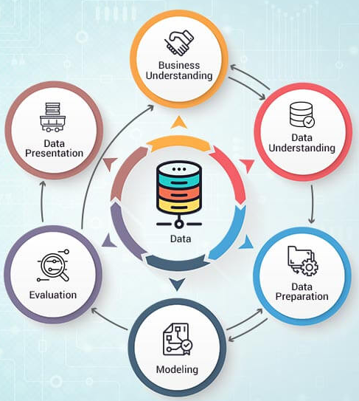
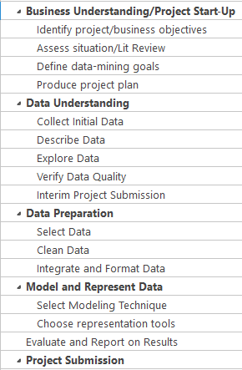
Methodology
Based around CRISP-DM

Slide 12

DATA Visualisation approach – ANDY Kirk

Slide 13
Technologies
Used R to get the data into a tidy format from SPSS and R file for analysis and then wrote the results to a csv file
Some initial exploration in R – survey package, crosstabs, chi-square
Tableau to visualize the data and put it into a story using dashboards
Tableau better for story telling and for user insights
Having related data side by side gives new insights

Slide 14
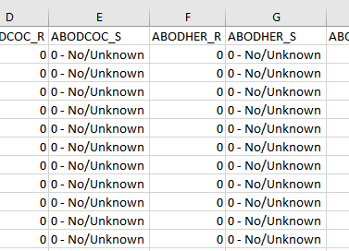
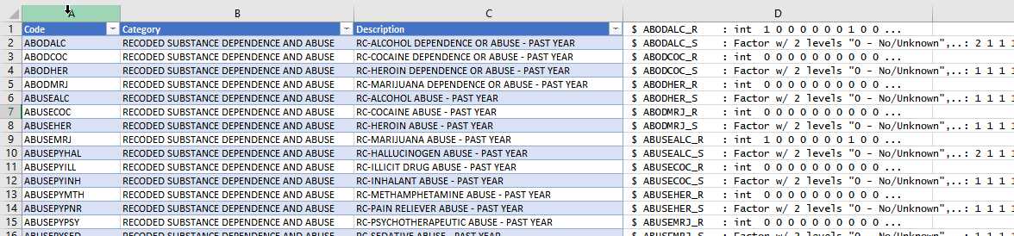
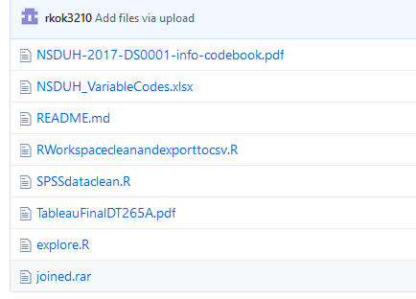
FILES
Source of data SPSS, R Workspace and TSV files

Slide 15
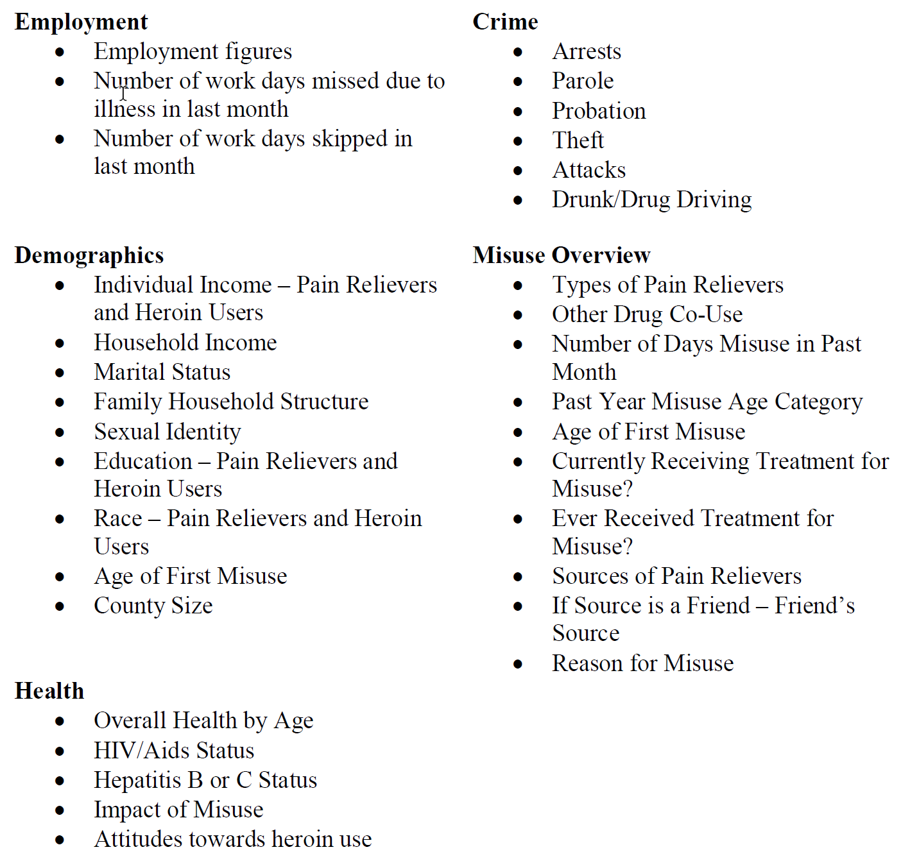
Presentations of Results
44 visualisations (worksheets are hidden)
11 dashboards presented in one storyboard

Slide 16
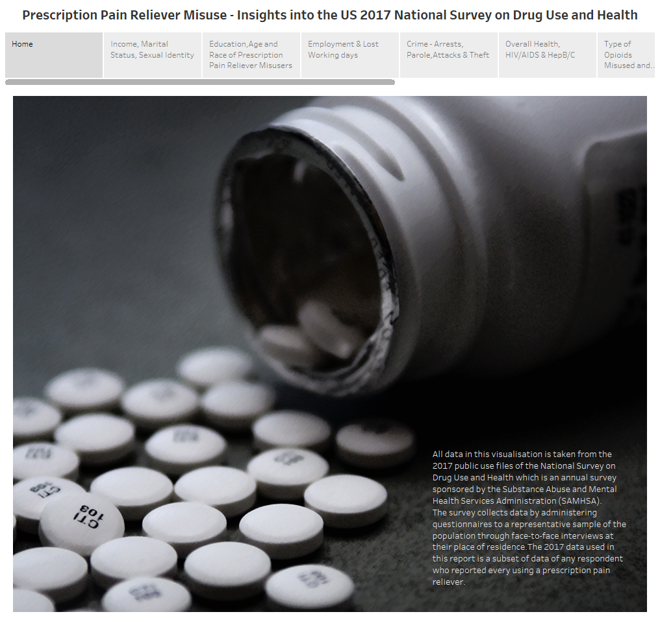
Presentations of Results
Approx 10 million prescription pain reliever misusers in 2017
Mainly White
All Incomes, All Ages
Racial and Age Differences

Slide 17
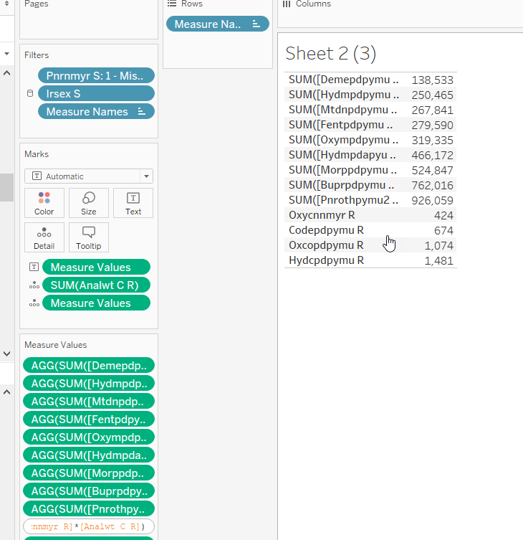
Behind the scenes
Renaming Variables, Grouping Subtypes, Aliases
Adding calculations for colours, details, tooltips etc.
Including Survey Weights
Layout and Design
Colour Palettes
Checking Calculations, Rounding Percentages

Slide 18
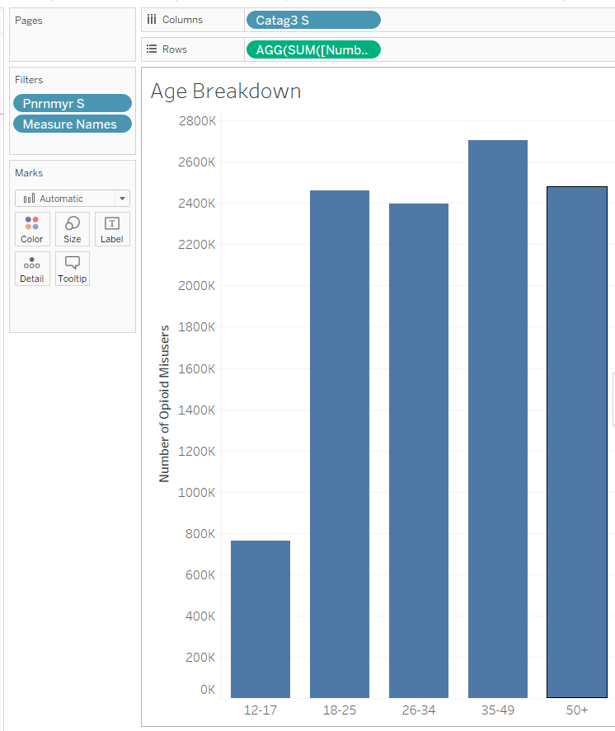
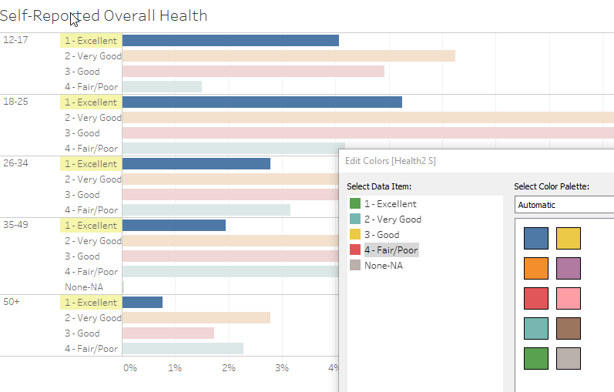
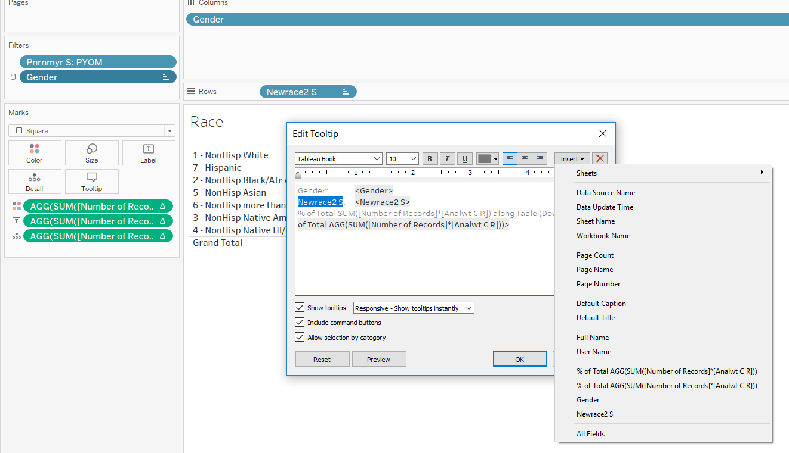
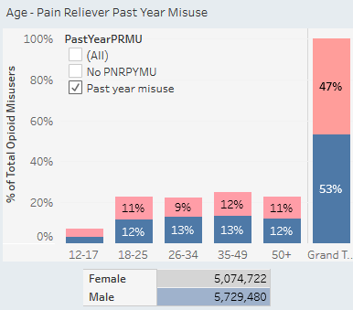
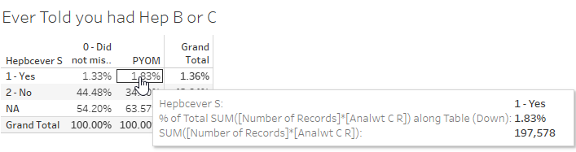
Behind the scenes

Slide 19
Evaluation
Good insights into the data
Variations by race, age and gender evident
More worked needed on presentation and formats
Dataset should be reduced

Slide 20
Future Work
Layouts for different screens
Colour palettes/Standard tooltips/Calculated fields
More visualisations and explanatory text
Look at trends over time
Access restricted access data containing geographical data
Look at predictors of misuse
Looks at mortality rates versus misuse

Slide 21
Challenges
Size and complexity of data set
Categorical nature of data
Hardware load
Tableau configuration
Time management
Notes:
860 page codebook, 2660 variables

Slide 22

Conclusions
Tough but worthwhile exercise
Learned a lot about R and Tableau
Scope to fit timeline better
Read less, code more

Slide 23
Questions
?

Slide 24
Thanks For your time

Slide 25
Prescription Pain Reliever Misuse Analysis of the US 2017 National Survey on Drug Use and Health
File created on: 21/05/2019 19:07:53 from Tableau

Slide 27
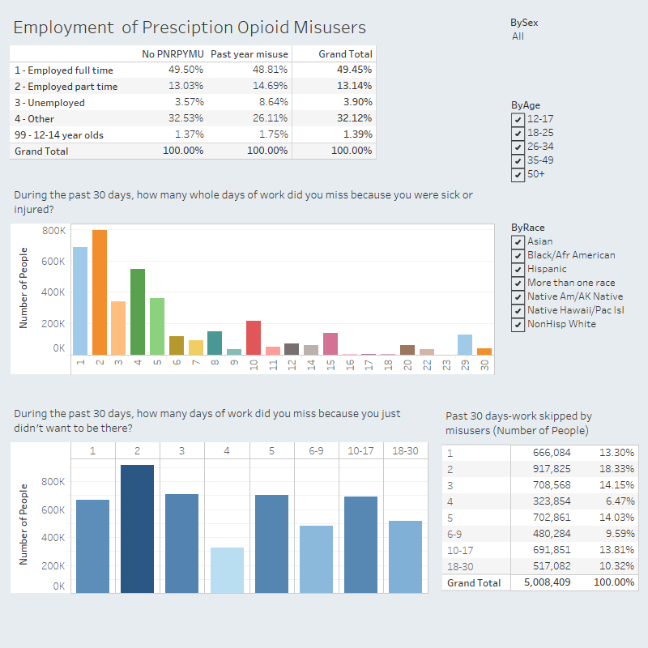

Slide 28
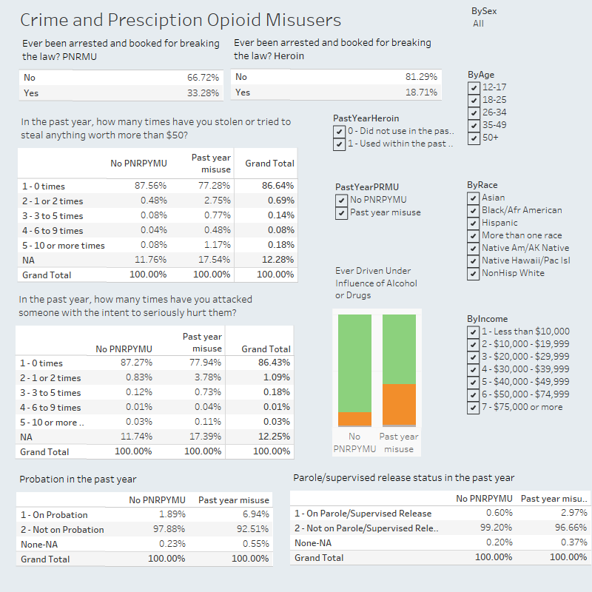

Slide 29
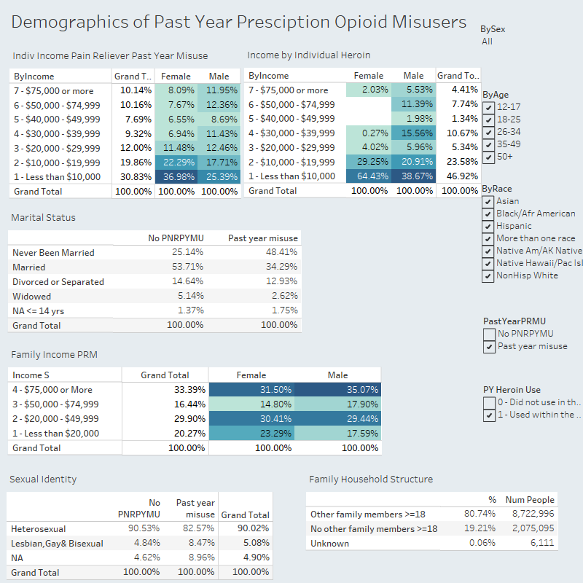

Slide 30
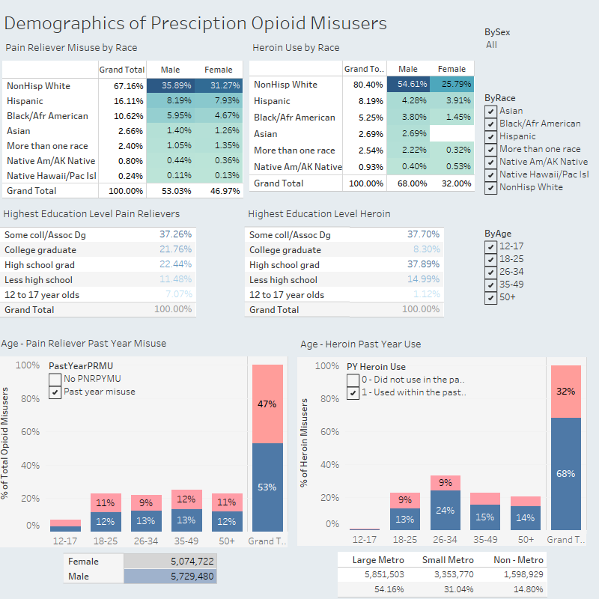

Slide 31
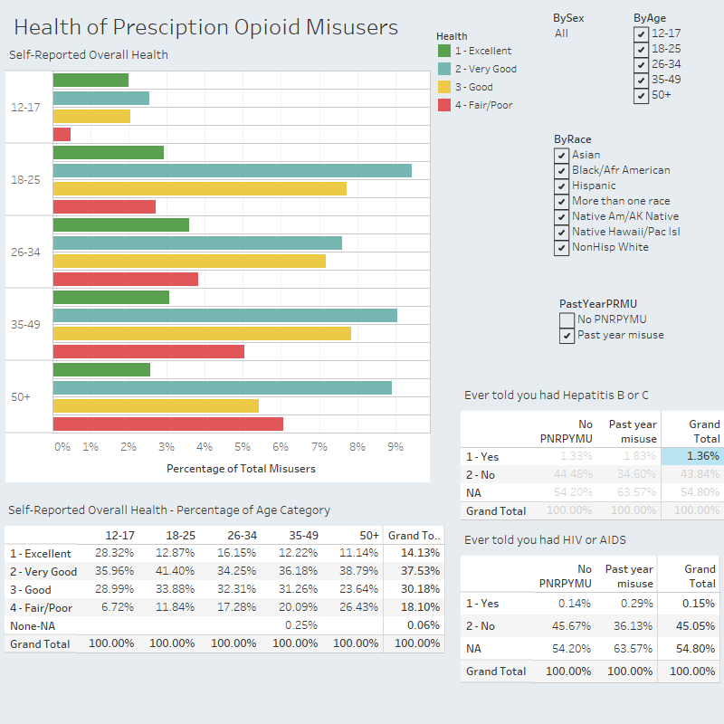

Slide 32
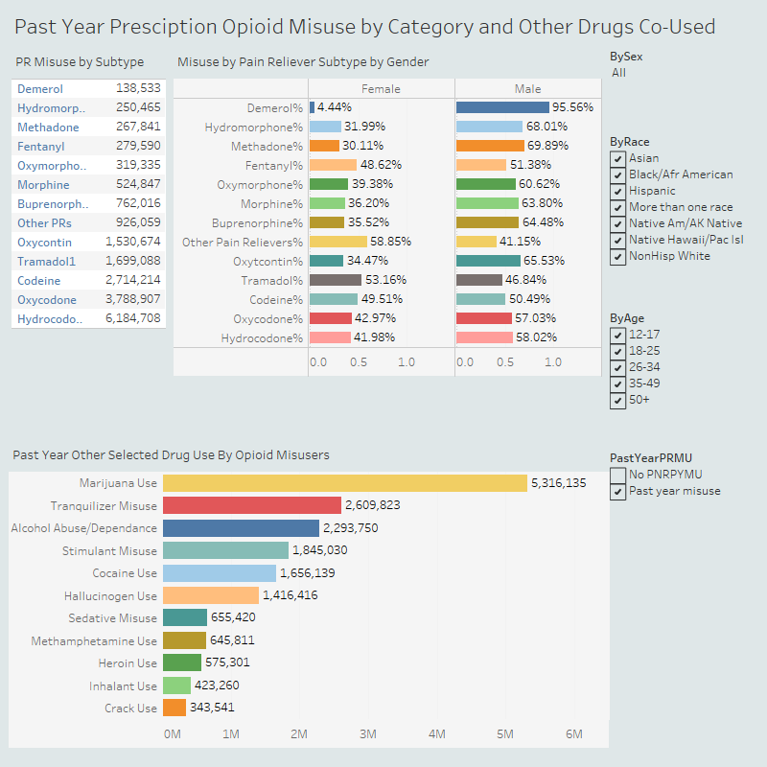

Slide 33
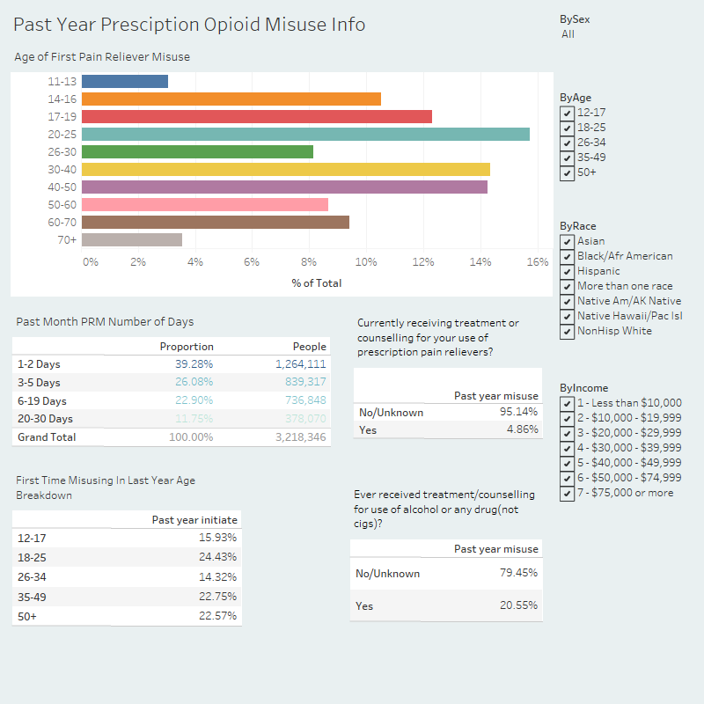

Slide 34
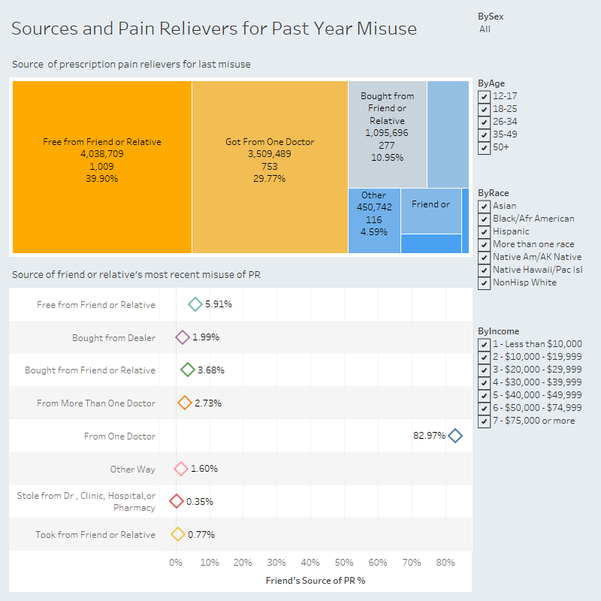

Slide 35
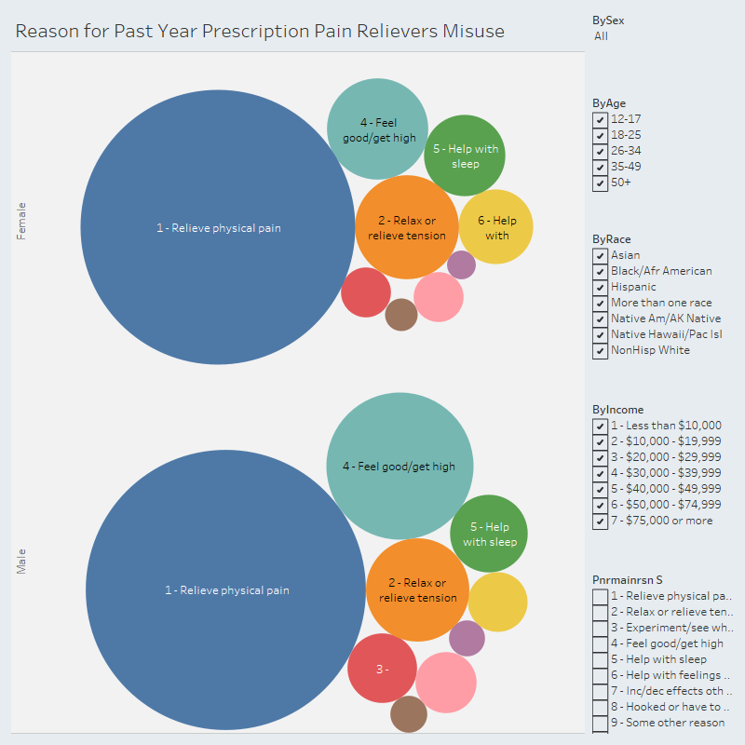

Slide 36
